Slide 1

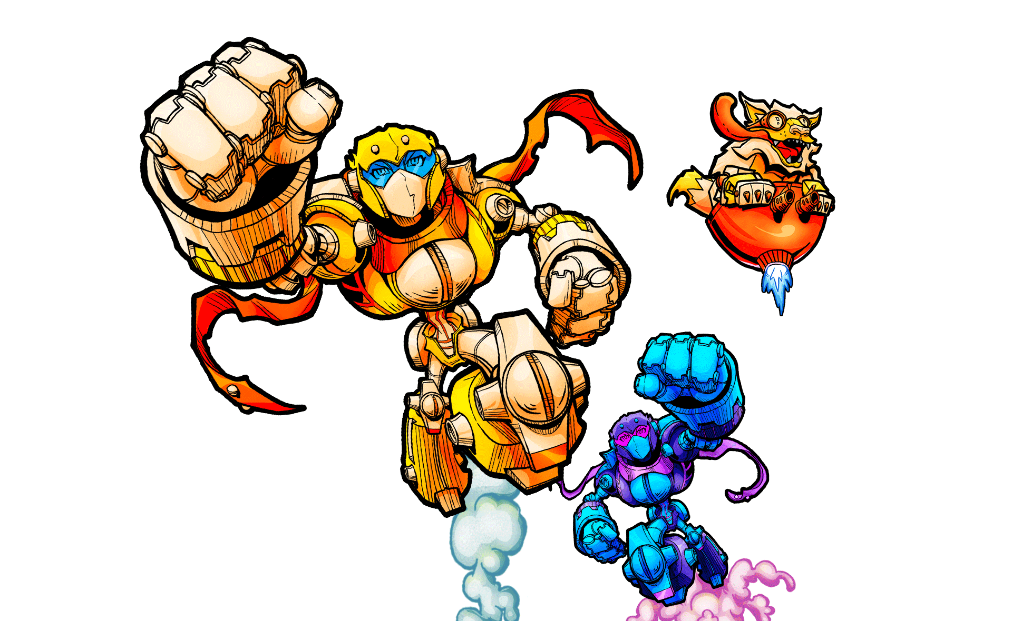
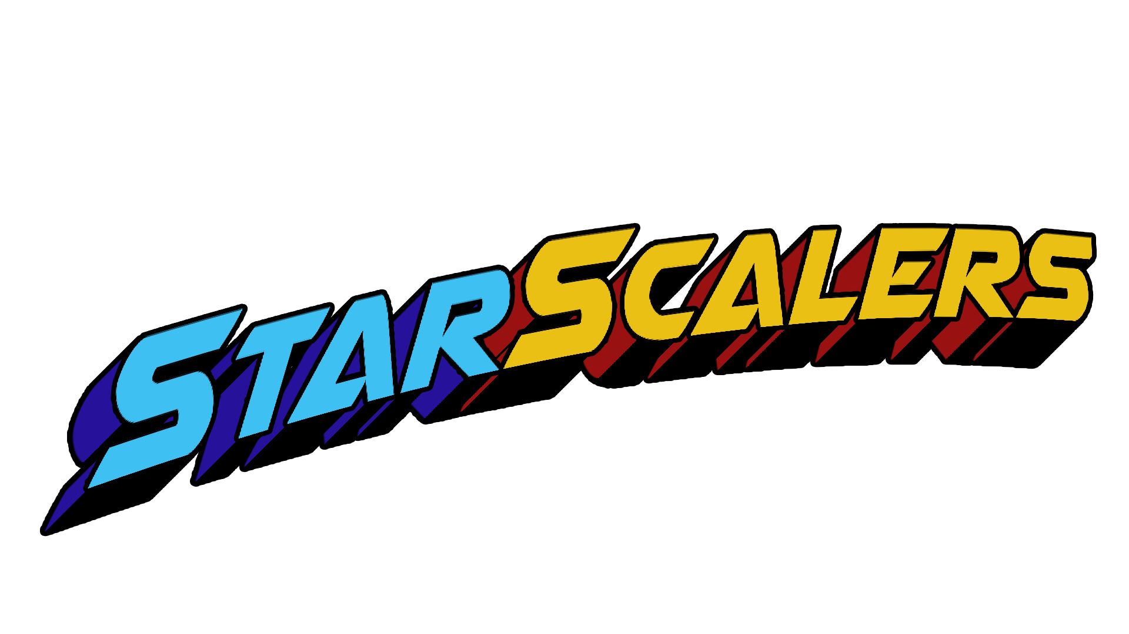

Speedy to savage in seconds

Slide 2
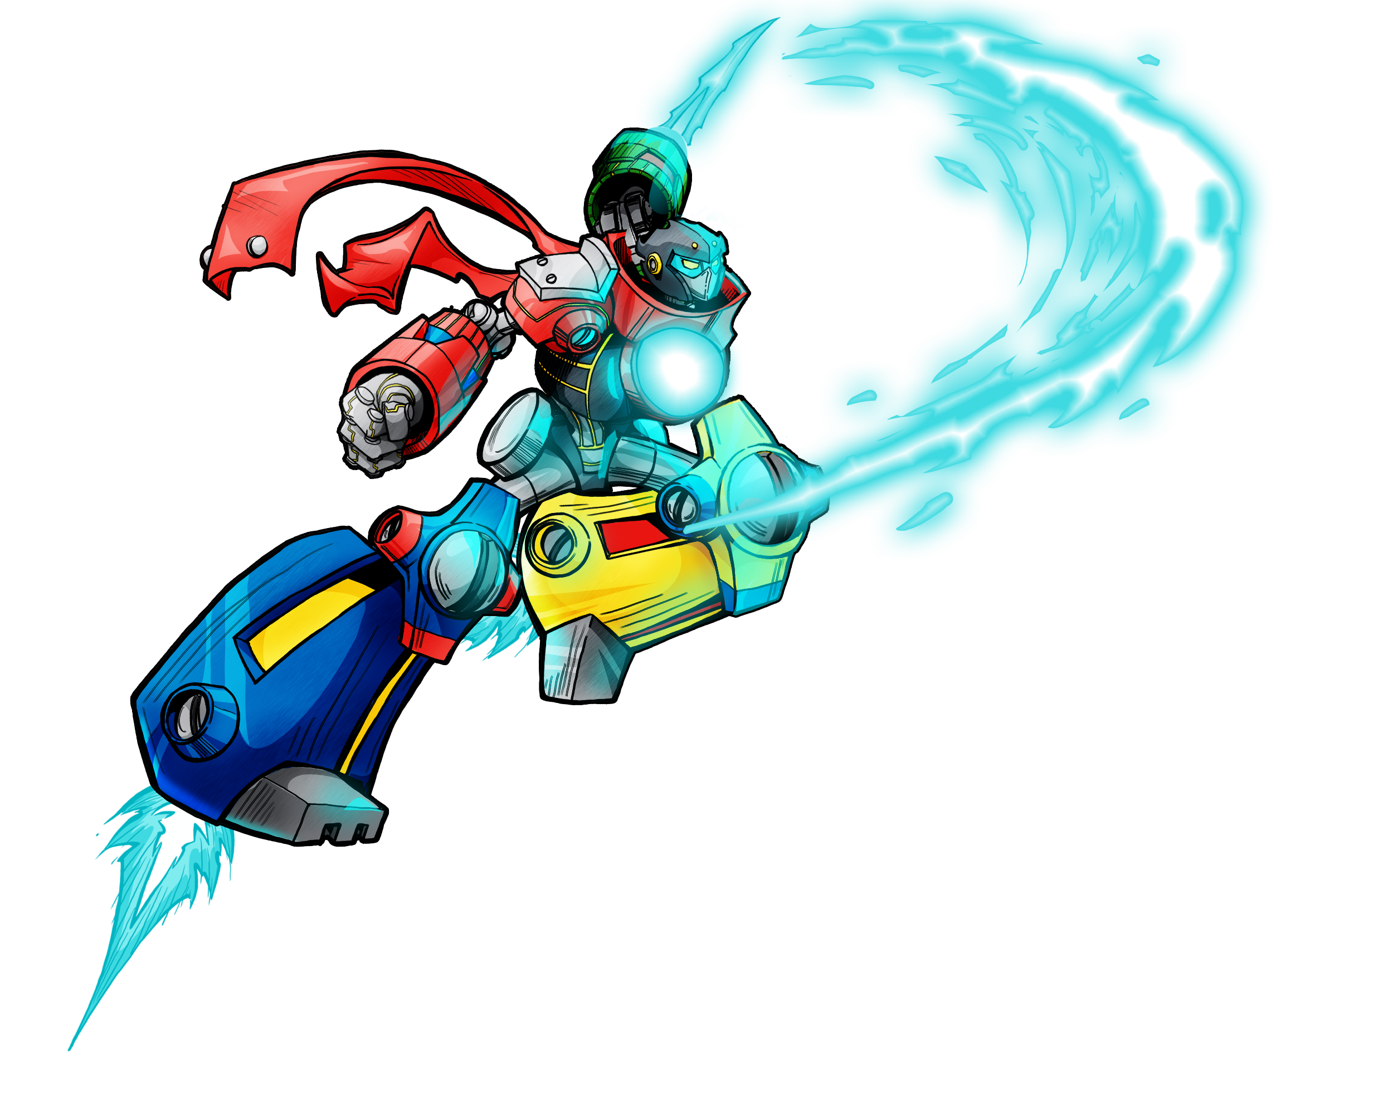
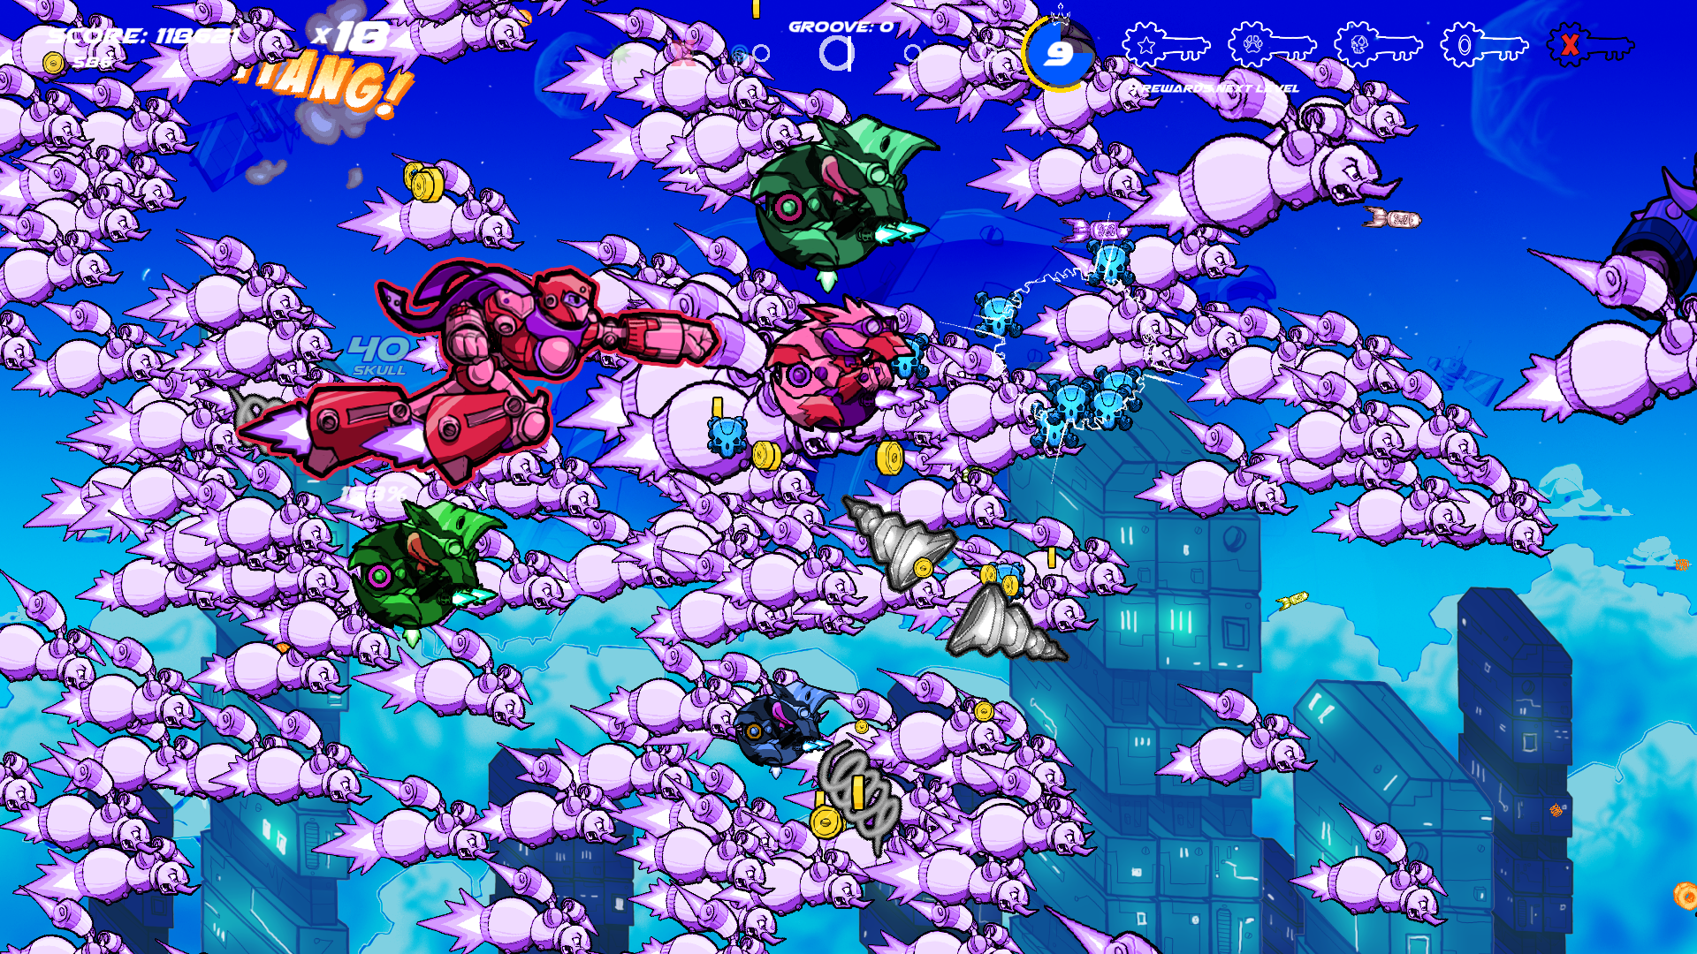
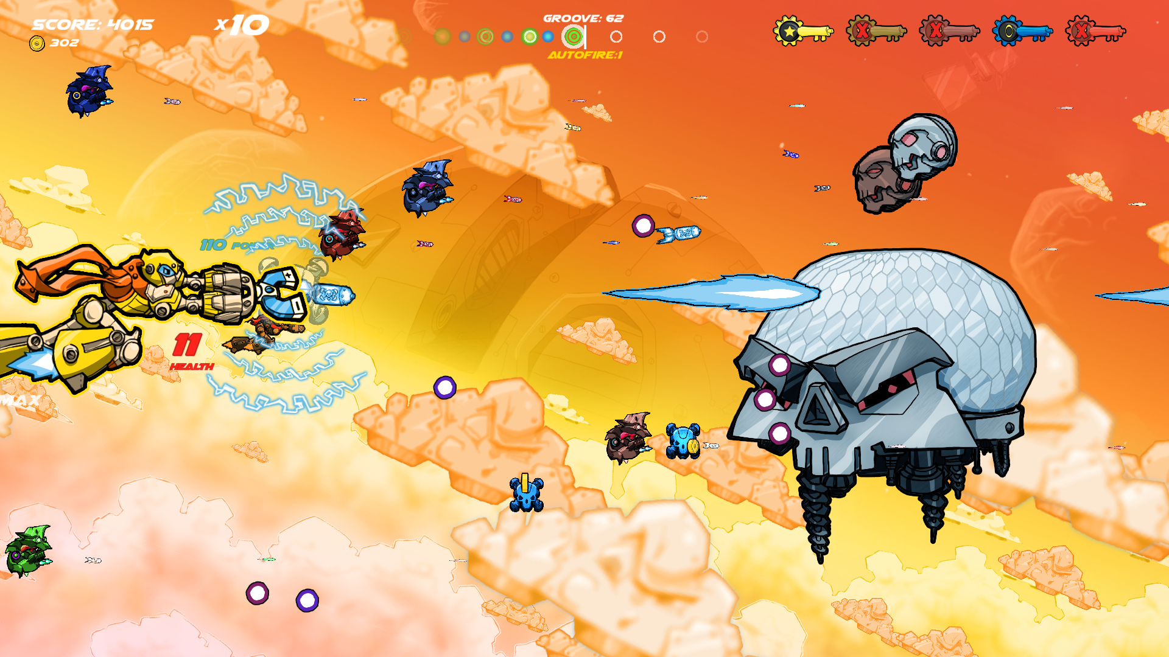
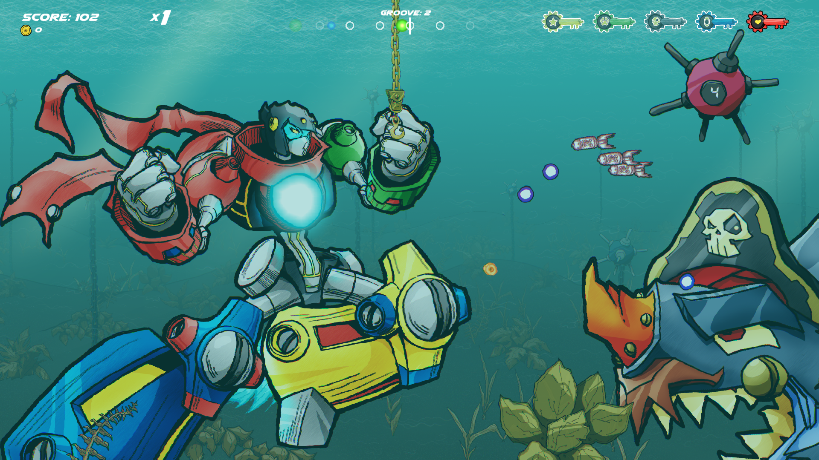

Innovating chaos
StarScalers is a high-energy shoot-em-up where players control Scale Transfiguring Aerial Roboninja (S.T.A.R.) units, piloted by a race of mecha-dogs who are investigating a strange airborne threat.
Dynamic Size-Changing – Shrink for speed, grow for power. Any time, all the time.
Powermagnet System – Use almost anything on-screen as a weapon or trap, including the enemies!
Fight the boss WITH a boss – Complete optional objectives to unleash the indestructible A-Tron.
Co-op evolved – Never say die! Earn your way back into the game by assisting your partner as a wing-mutt.
See
Intro
Groove Guard – Sync your shots to game music – or YOUR OWN – to command Echo Squad.

Slide 3
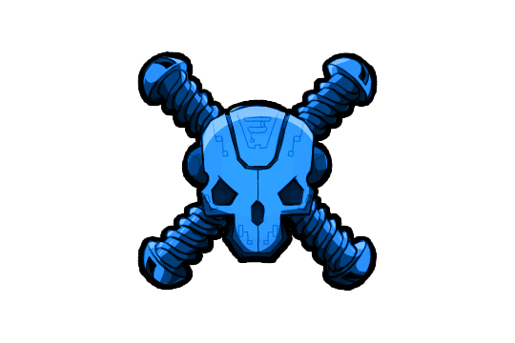
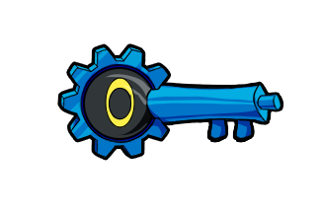


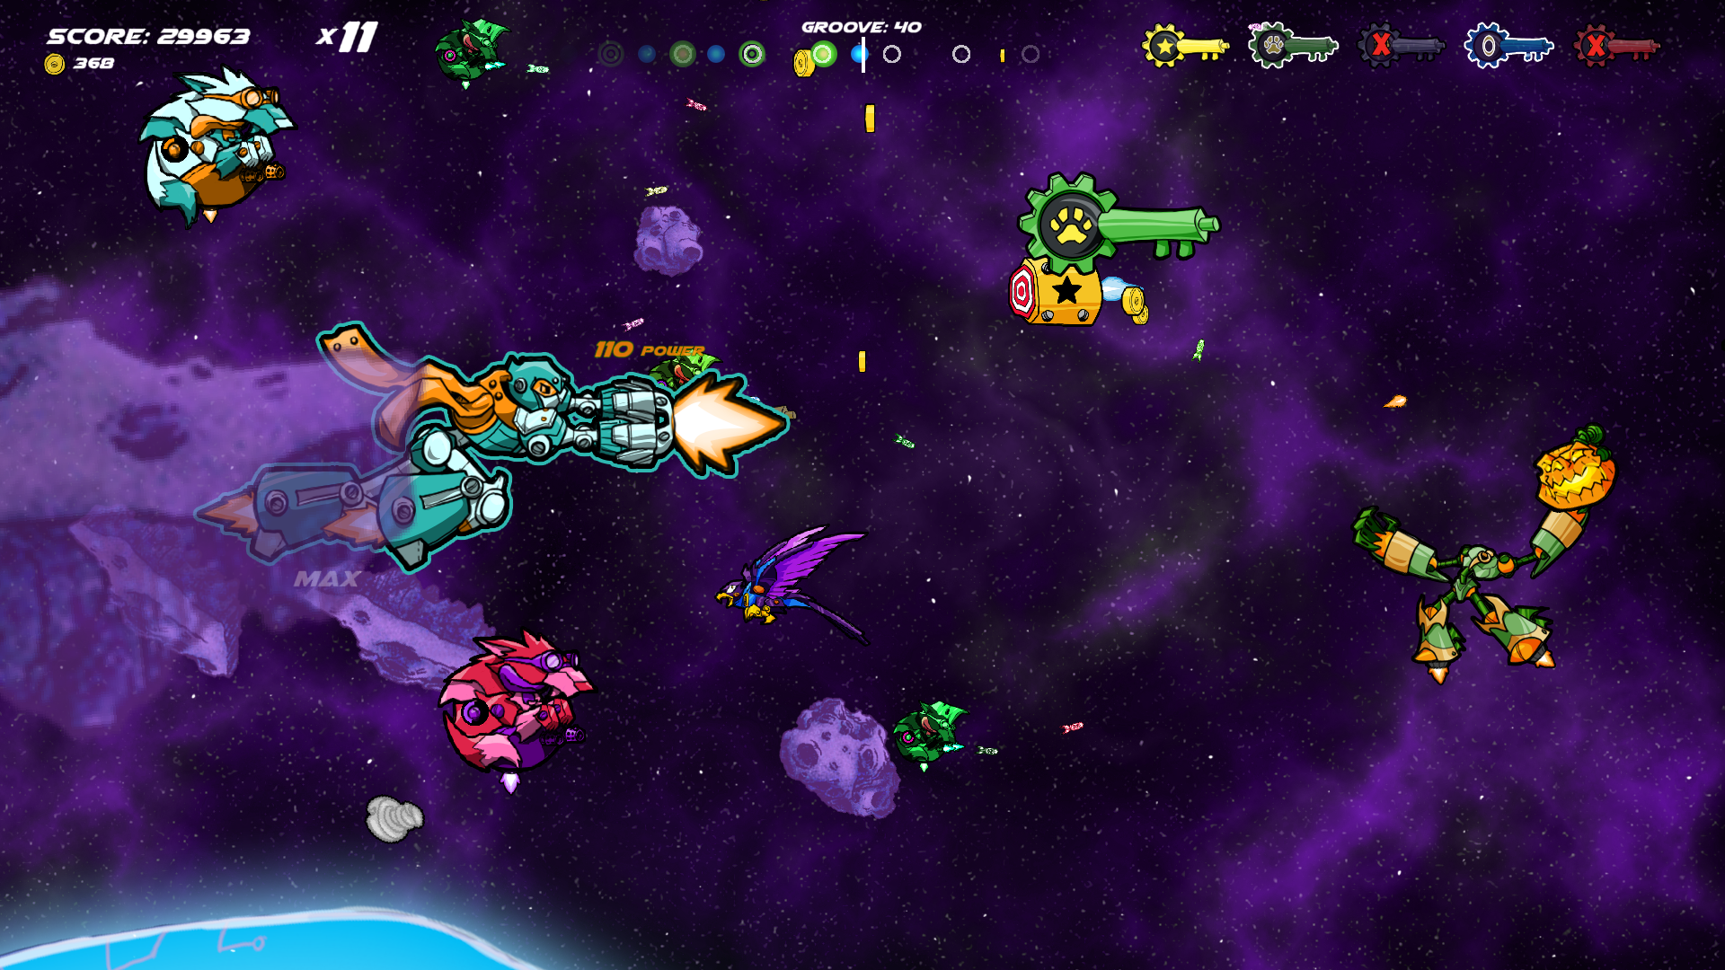


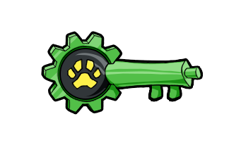
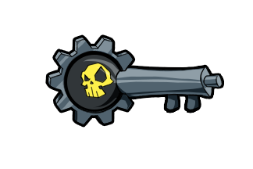
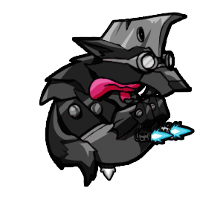



Too many ways to win – adhd-inspired design
The game tempts the player with many options for domination. Greed or impatience will result in death, but great rewards await those who learn to filter the noise and focus on one objective at a time. What will YOU prioritize?
Unlocking the powerful A-tron for a swift boss fight?
Star Coins? Buddies? Rings? Enemies? Health?
Fueling your ultimate attack?
Coins for upgrades?
Rescuing wing-mutts?
Environmental traps?
Using your enemies?
Finding your rhythmic groove?
Co-op advantages?
Survival or Campaign?

Slide 4

















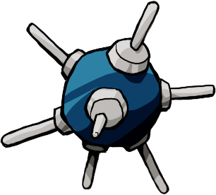
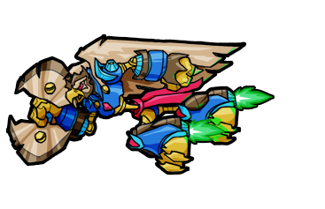
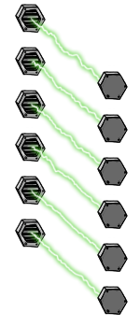


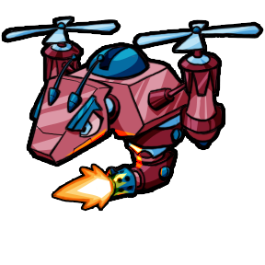
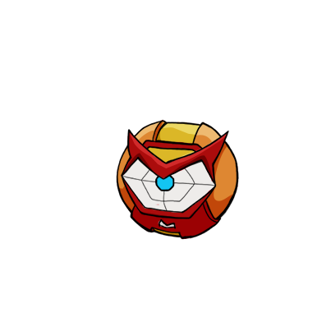


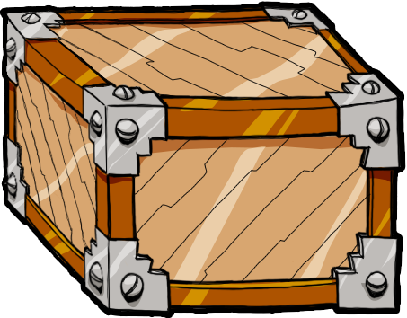
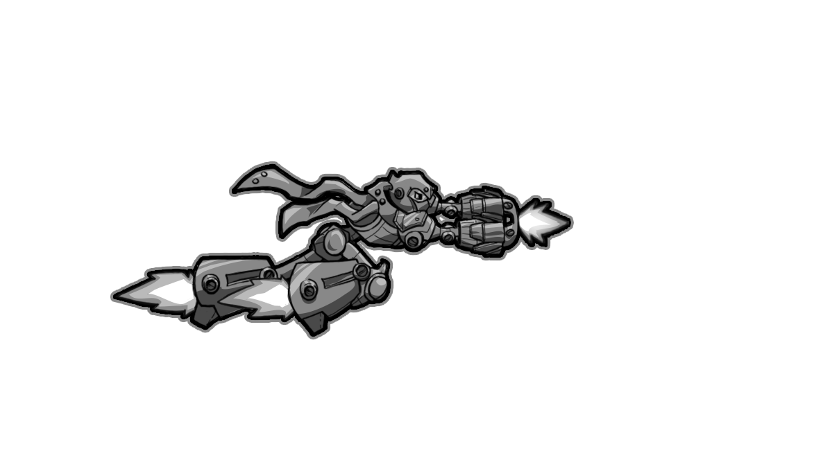
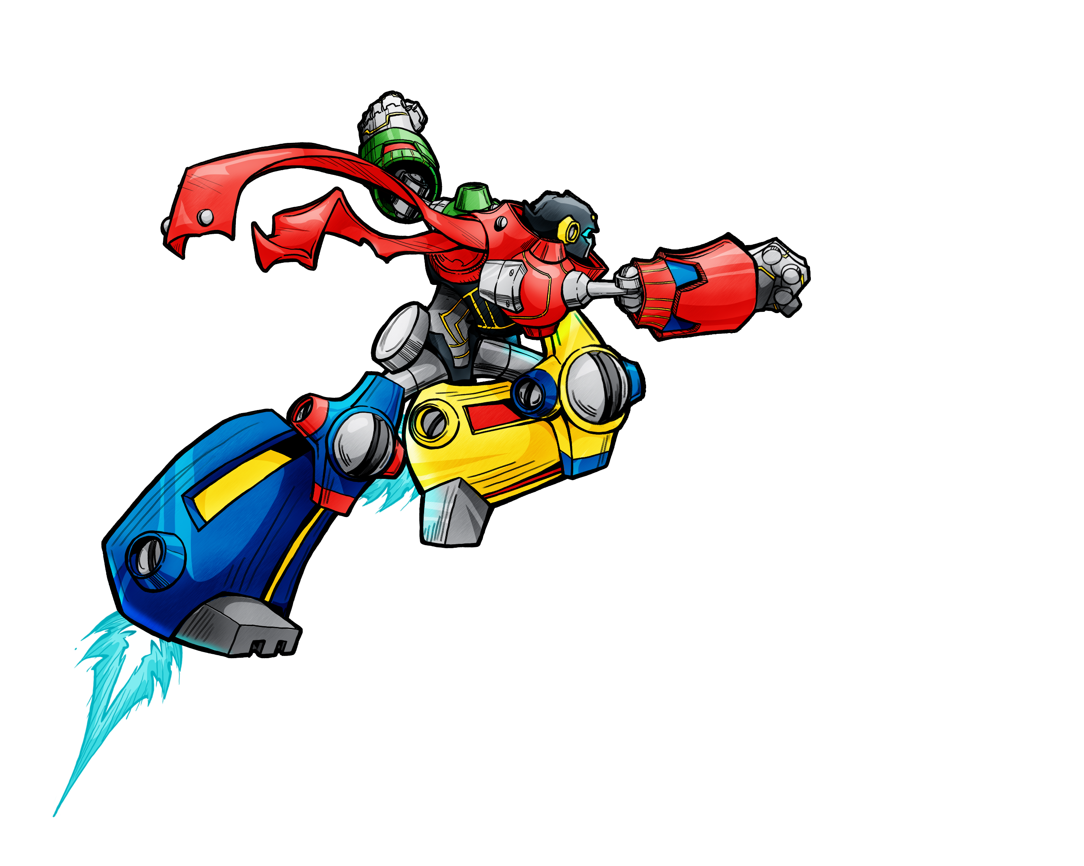



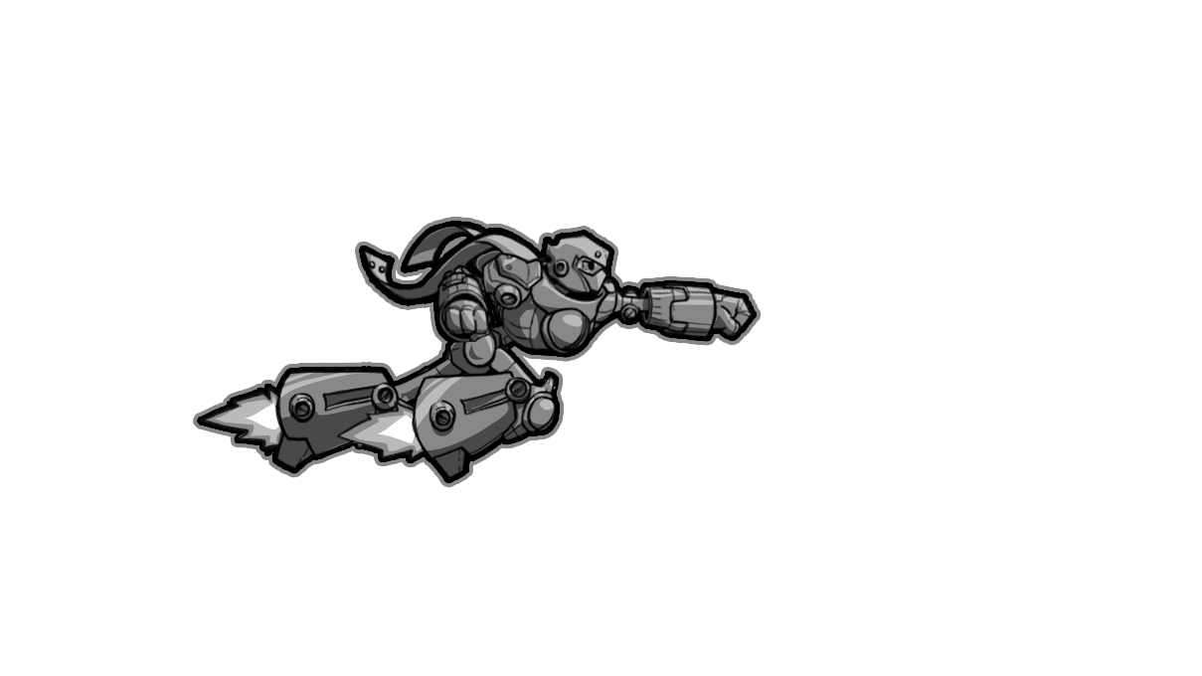
Promoting creativity & connection
StarScalers gives you tools that feel like toys:
Experiment with unbalanced weapon choices!
Weigh the implications of scale, range, damage, and consumption.
Play the music, literally!
Learn the basics of drumming and discover key phrases to remix the game action!
Manipulate the environment with the Powermagnet!
What will you grab, launch, smash, or commandeer?
Partner up with players of any skill level!
Tag team moves, dynamic assists, and healing. Work together to control A-tron!

Slide 5
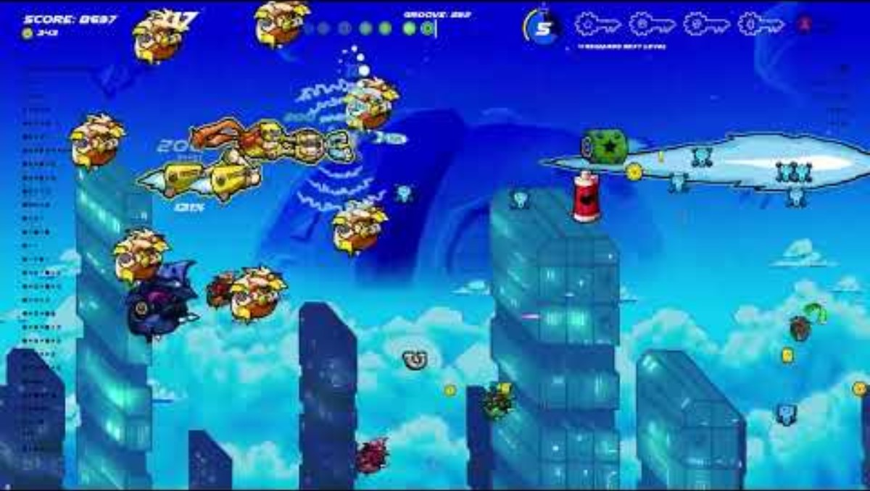
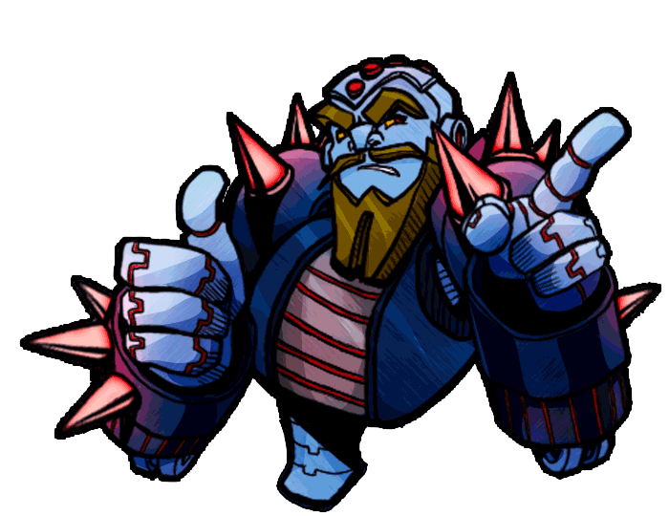

Groove guard – sync. Command. Amplify.
It’s a fully realized game on its own, but you can take it to the next level with a fresh Zen-based rhythm feature.
Groove Guard is StarScalers' most expressive layer. Players unlock it when they’re ready—then trigger percussive attacks in sync with the beat. As your sense of rhythm sharpens, so does Echo Squad—your beat-driven drone crew who mimic your firepower and swarm the screen. The system rewards creative, satisfying timing without prescribed presses or overly strict timing. Rhythm becomes a form of power—not stress.
Turn off the game’s music and drop in your own—Groove Guard transforms StarScalers into a new interactive listening experience, a genre evolution.
Check out groove guard gameplay! Stick around or fast forward to catch a glimpse of survival level one chaos!

Slide 6
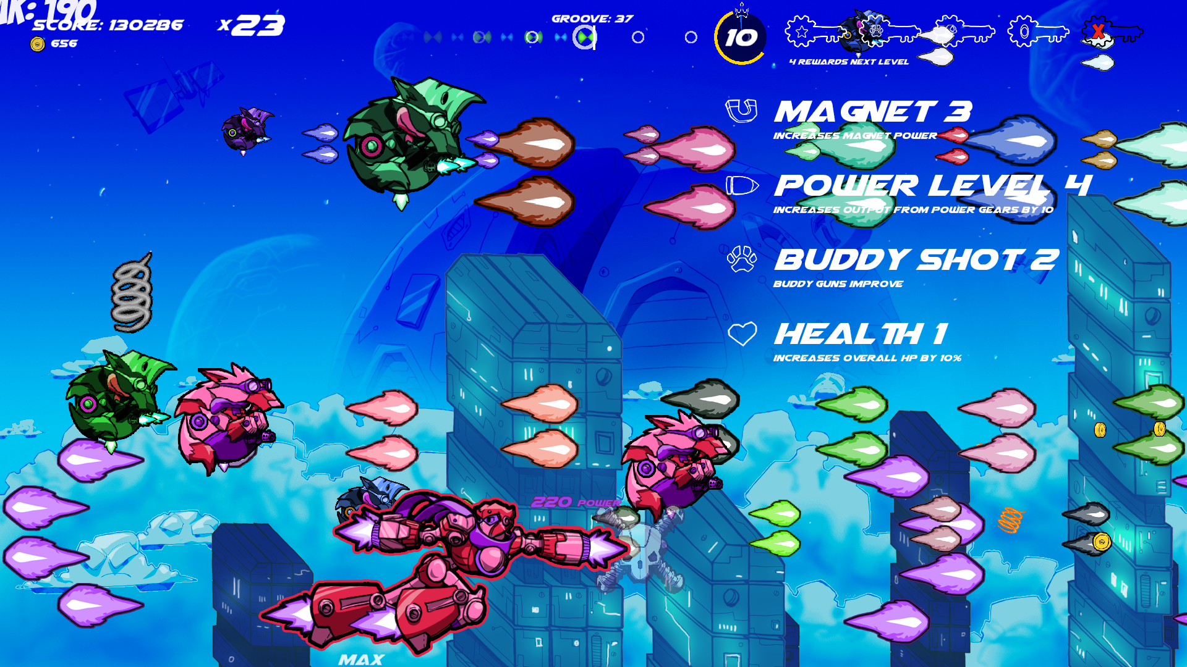
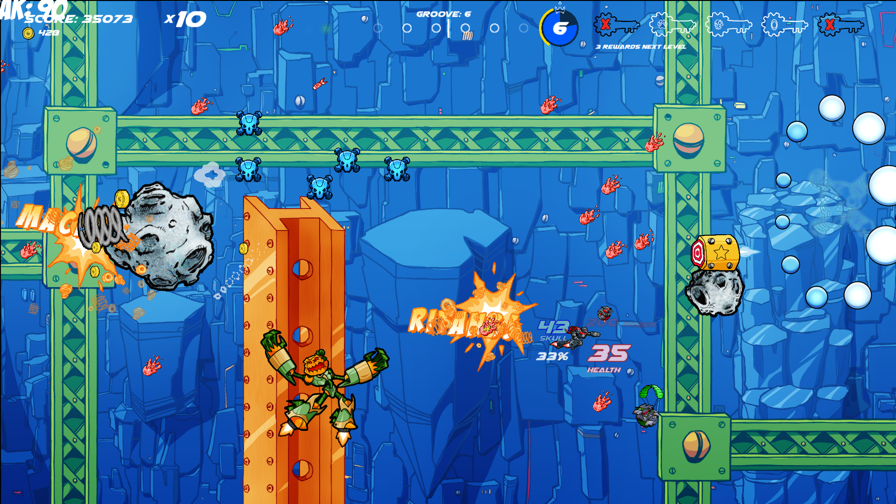
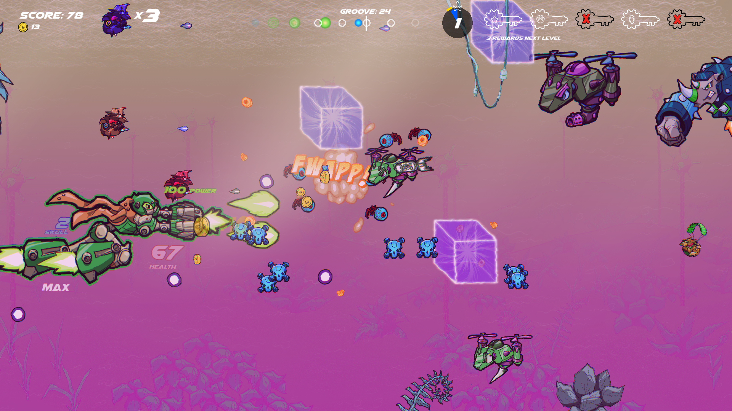
Survival mode – from underdog to top dog
Each stage completion unlocks a survival remix with reimagined visuals and randomized enemies / obstacles.
Start weak, build power: earn random upgrades for every intact objective upon leveling up.
Farm for coins while test-driving the abilities they can unlock to improve your campaign chances.
Endless Chaos: the baddies escalate, but so do YOU. Reach screen-filling insanity – it’s Vampire Survivors, Shmup Edition!

Slide 7

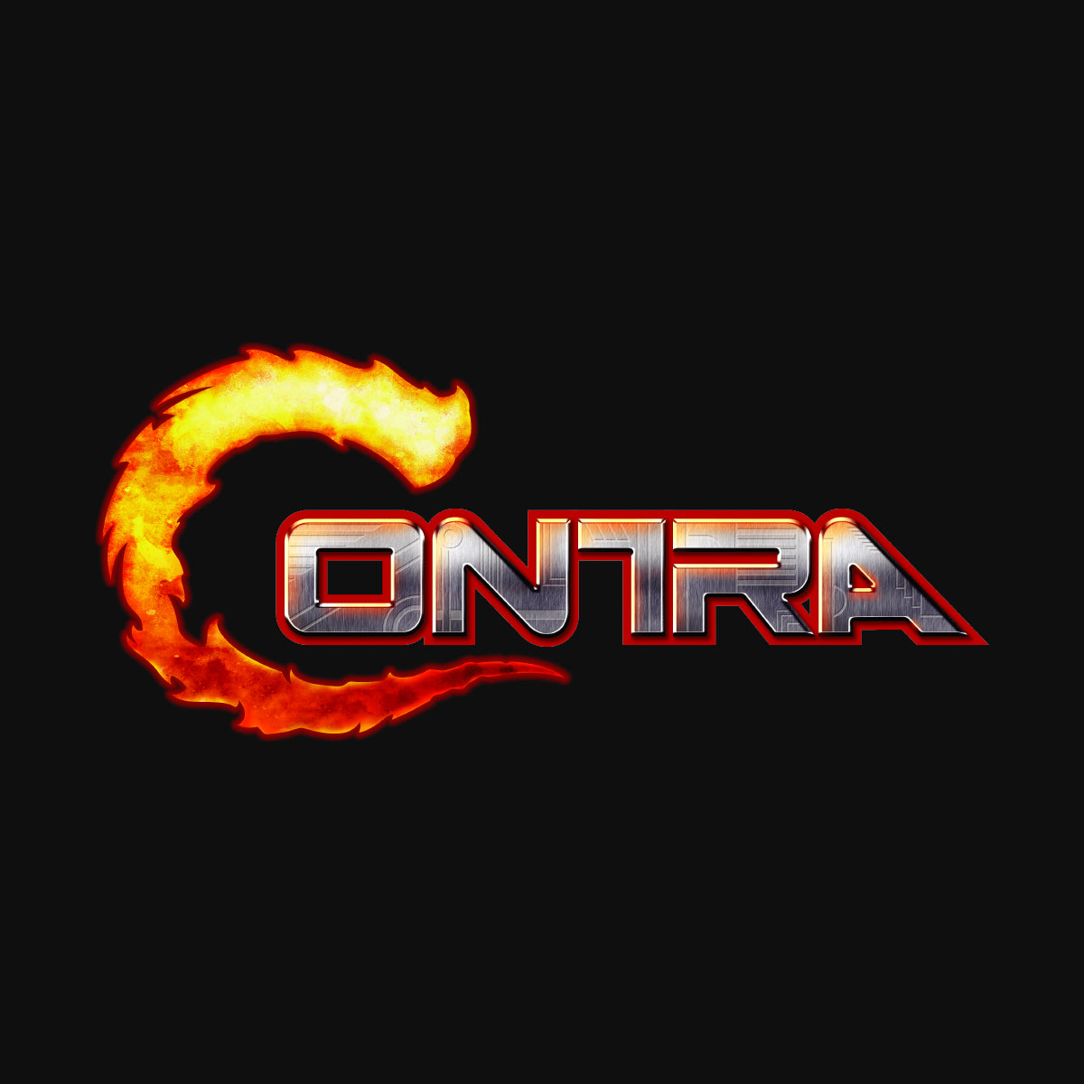
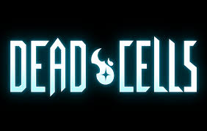
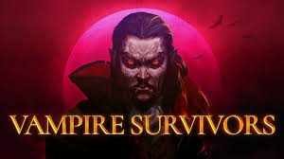

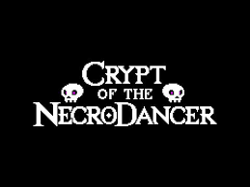
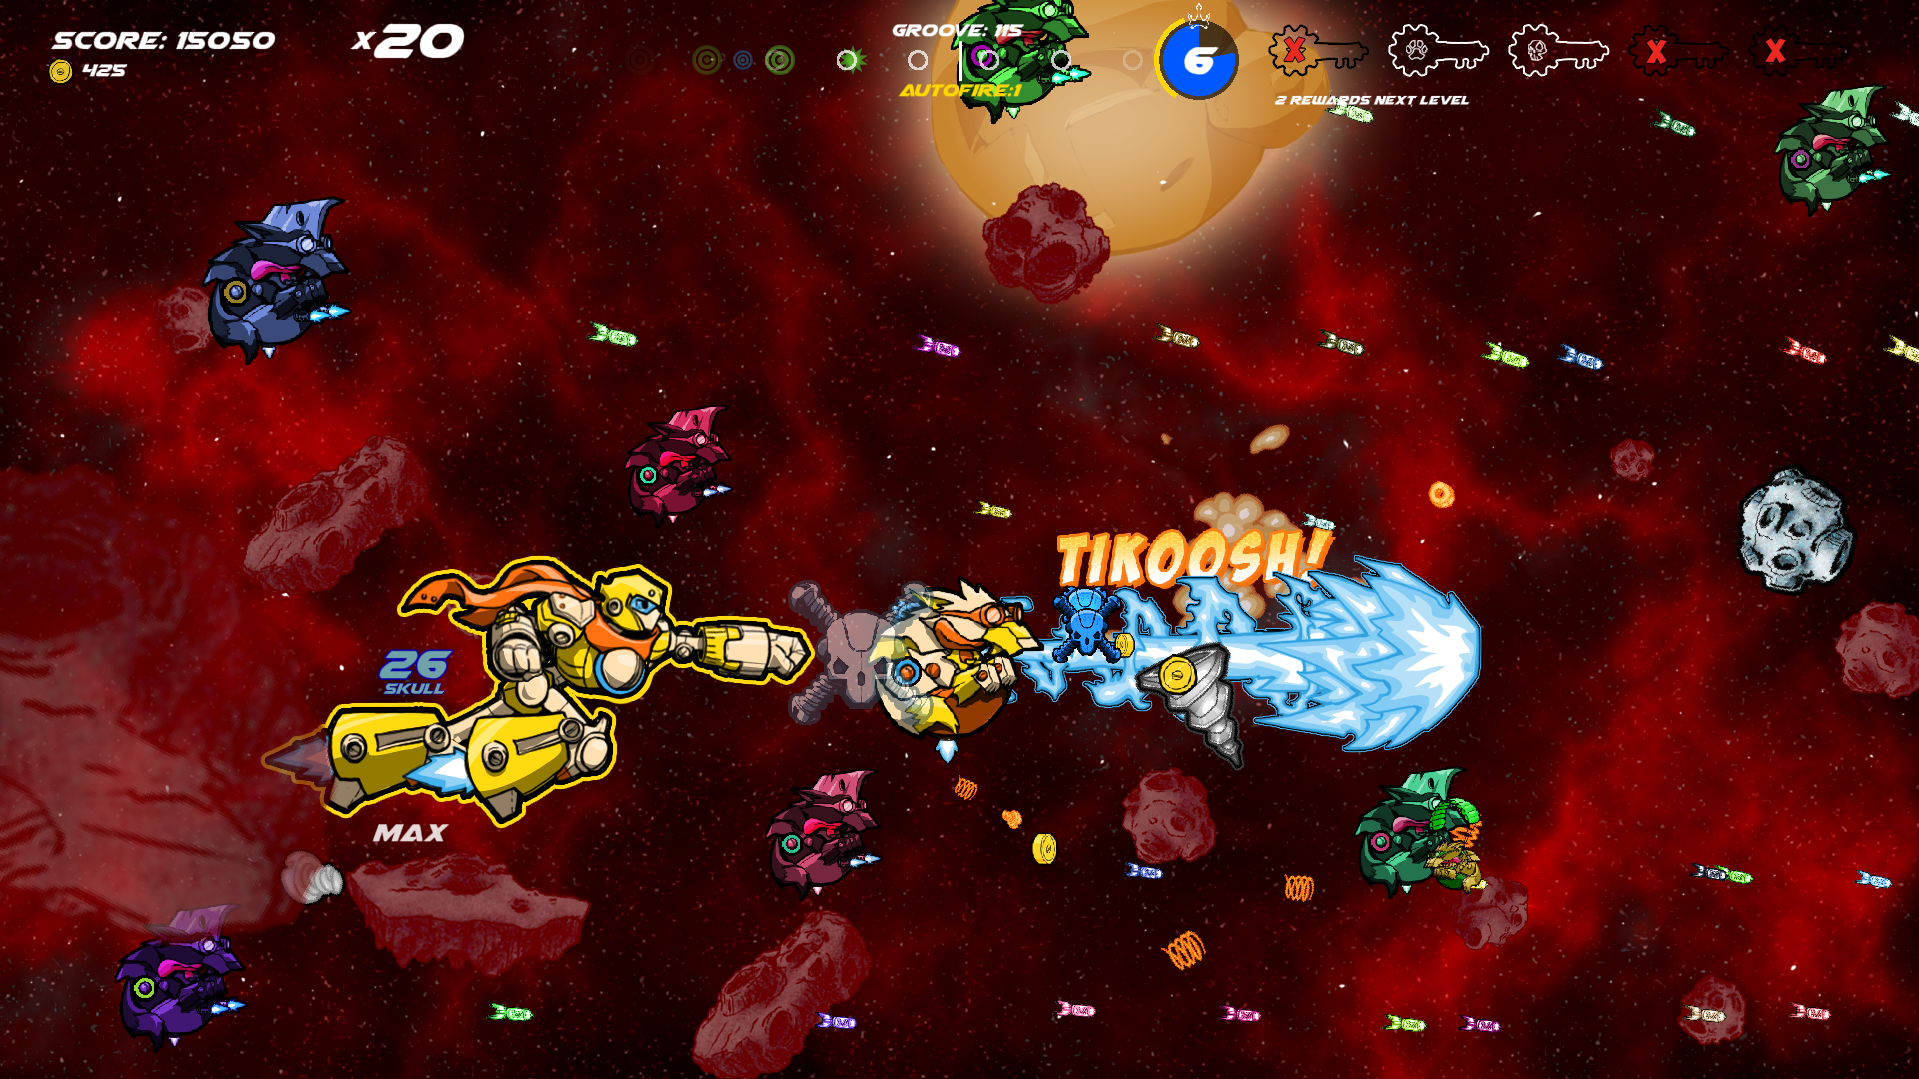



Target audience & market fit
Fans of fast-paced action
Shmup enthusiasts seeking fresh mechanics
Couch co-op fans & casual gamers
Rhythm-curious players & music lovers
Kids of all ages who love cartoons, comics, and family friendly mischief
Dog lovers
ADHD brains looking for their perfect storm

Slide 8

Development & progress
All core mechanics implemented
4 full stages complete, each with 3 unlockable difficulty levels + survival variant
All menus, tutorials, transitions
Tons of upgrades, unlockables, customization
Solo Developer: Doug Pohl (programming, music composition, design, color, art wizardry, video)
co-founder, creative director of SwordSwipe Studios
Engine: GameMaker Studio
Development time: approx. 1 year (part-time development to date)
Target: At least 8 campaign stages, potential bonus levels, unlockable vs. mode
With publisher support, I can polish and expand faster

Slide 9
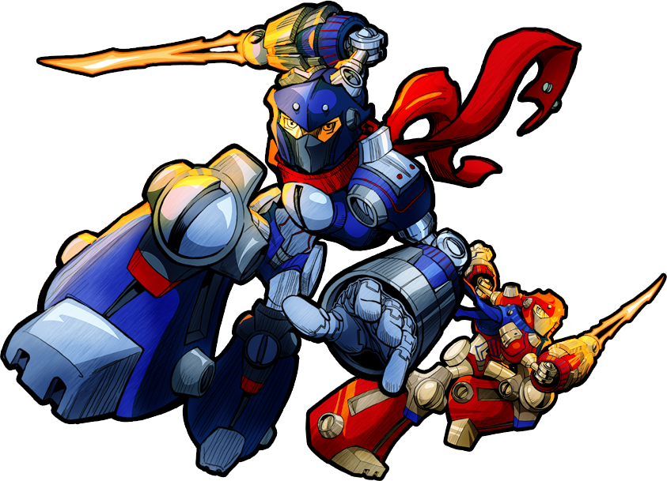
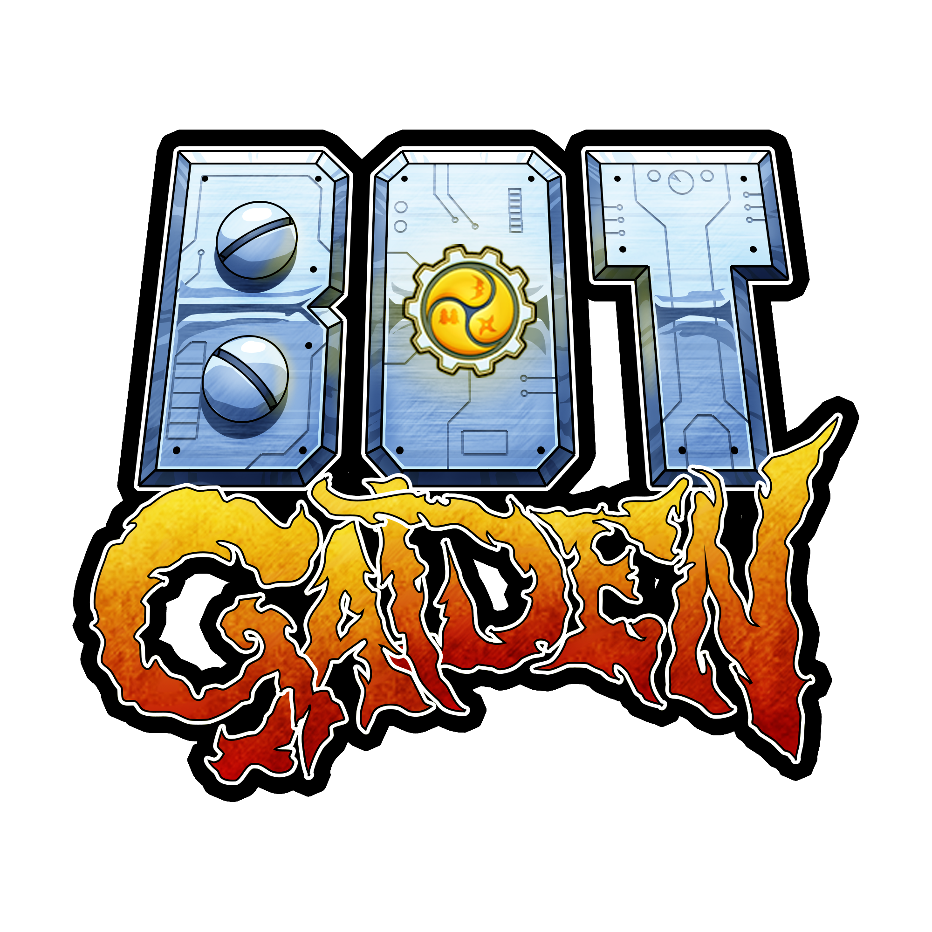






Why partner with me
StarScalers is 100% unannounced, giving publishers an exclusive first-look opportunity
Proven Execution: Bot Gaiden (SwordSwipe Studios) launched on all major platforms
Unique Positioning: A shmup with depth, humor, and accessibility
Innovative Mechanics: Size-changing, powermagnet, groove guard, mecha fights, co-op assist
Charm: Vibrant visuals, thumping soundtrack, and genre fusion appeal

Slide 10

Let’s work together
Marketing & Visibility
Console Porting & Platform Support
Funding to Accelerate Full Time Development (optional)
Build Available! Contact Doug Pohl: pohldoug@gmail.com
[NOTE: Visual: A-Tron reveal, Groove Gang celebration, or full chaos shot to close with energy.]

